Slide 1
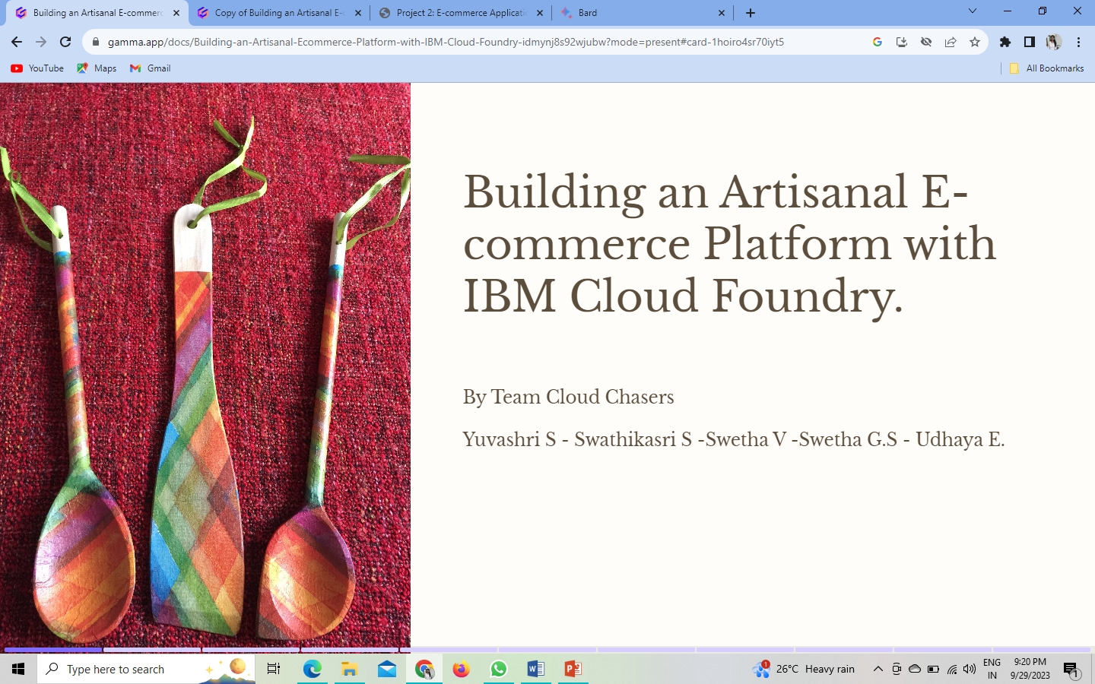

Slide 2
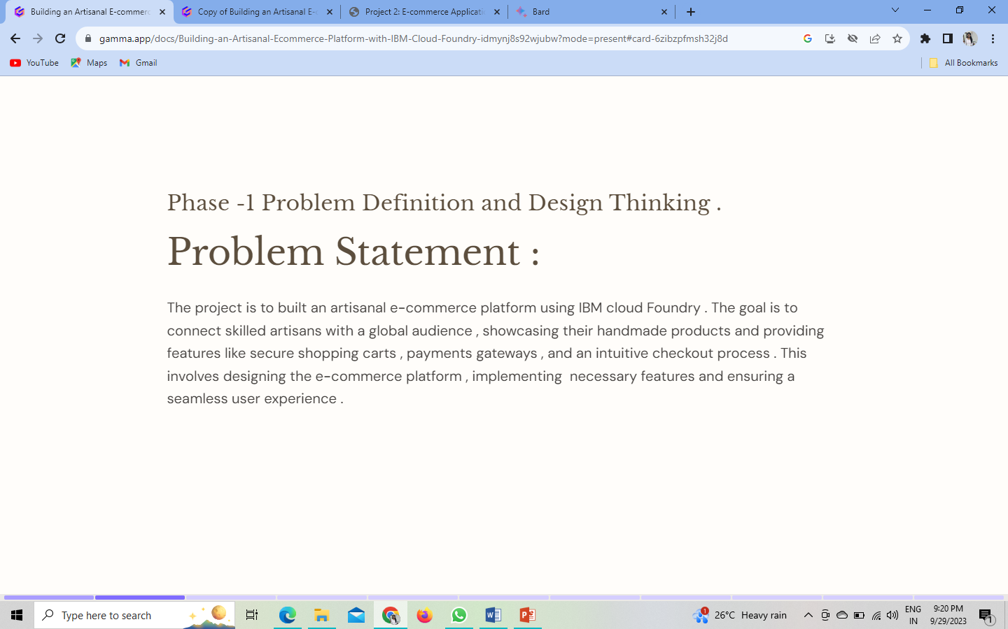
PHASE – 1 Problem Definition & Design Thinking

Slide 3
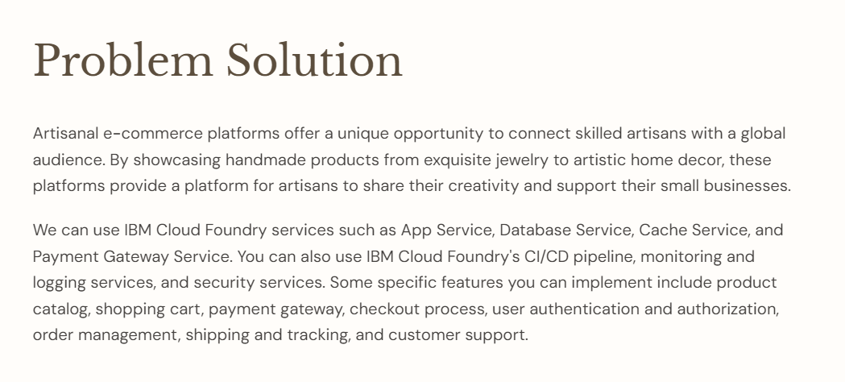

Slide 4
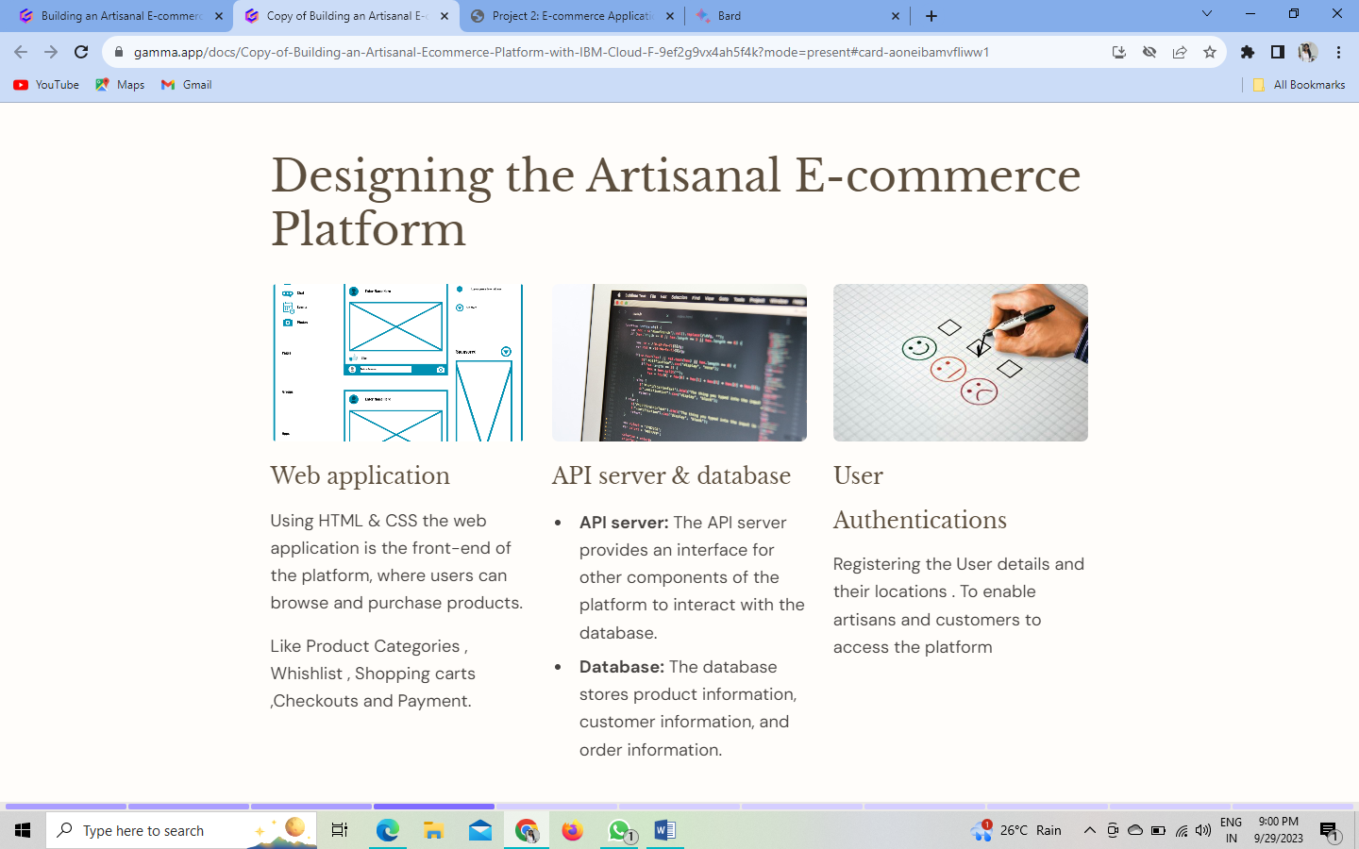

Slide 5
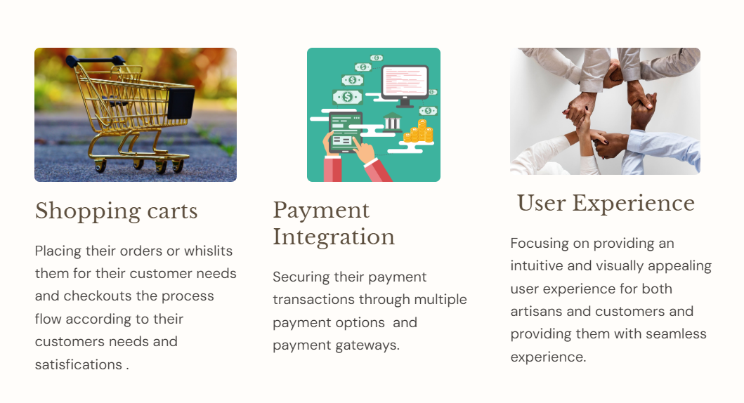

Slide 6
Conclusion :
In summary, this project aims to create an artisanal e-commerce platform using IBM Cloud Foundry. Its primary objective is to connect skilled artisans with a global audience, allowing them to showcase handmade products and offer secure shopping with features like shopping carts and payment gateways.
The focus is on providing a seamless user experience and ensuring reliability. Success in this venture not only benefits artisans but also contributes to the e-commerce industry's growth. Continuous adaptation to evolving technology and customer preferences is crucial for long-term success, promising a mutually beneficial online commerce platform.

